Slide 1


Enterprise AI Strategy 2026
From Pilot Projects to Scaled Value: A Roadmap for Autonomous Workflows, Governance, and Measurable ROI
Prepared for Executive Leadership & Operations Committee

Slide 2

PART I
The 2026 AI Enterprise Landscape
Understanding the structural shift from basic copilot assistance to autonomous agentic workflows and measurable business value.

Slide 3


Adoption vs Impact Gap
High Tool Adoption (88%)
Low Scaled Impact (<10%)
Nearly 9 out of 10 enterprises have deployed generative AI tools across business functions. However, standard usage remains concentrated in unstructured task automation, copy drafting, and sporadic search.
Fewer than 10% of organizations have redesigned core operating workflows around AI. The market is shifting focus from vanity active-user counts to concrete bottom-line EBIT contribution.

Slide 4

Rise of Autonomous AI Agents
Beyond Human-Prompted Copilots
In 2026, enterprise AI has evolved from reactive chat interfaces to proactive autonomous agents capable of multi-step task execution across legacy business systems.
→
Cross-system API interaction without human intervention
→
Context-aware decision making in complex supply chains
→
Automated exception routing and operational audit trails

Slide 5






Three Pillars of AI Value
Agentic Workflows
Workplace Redesign
Responsible Governance
Deploying specialized AI agents to handle end-to-end operational processes, reducing manual handoffs and speeding up execution by up to 60%.
Rethinking job roles and workflows around AI collaboration rather than forcing AI into rigid pre-existing process maps.
Enforcing strict data boundary guardrails, regulatory compliance, and auditable lineage across all deployed intelligence tools.

Slide 6

The Enterprise AI ROI Gap
39%
Closing the Value Realization Deficit
While 88% of enterprises leverage AI, only 39% report direct revenue or margin expansion. Leading organizations achieve positive return by targeting high-volume operational bottlenecks using the FAST criteria: Frequent, Auditable, Simple, and Transferable processes.
Report Measurable EBIT Contribution

Slide 7
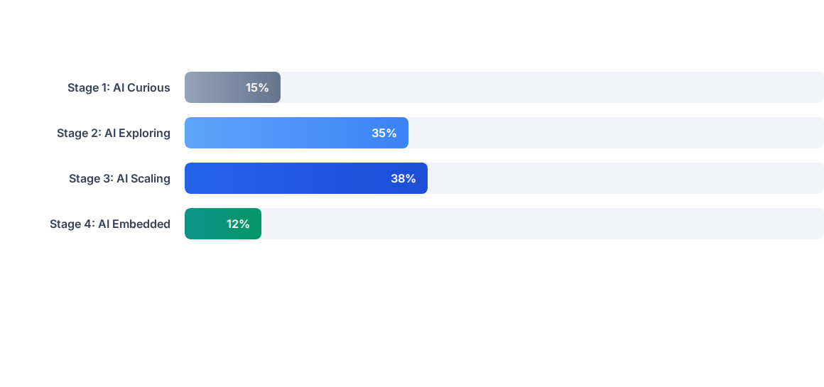
AI Maturity Distribution 2026
Most enterprises remain clustered in Stage 2 & 3. The strategic objective for 2026 is moving into Stage 4 (Embedded), where AI is integrated seamlessly into daily operating cadence.

Slide 8
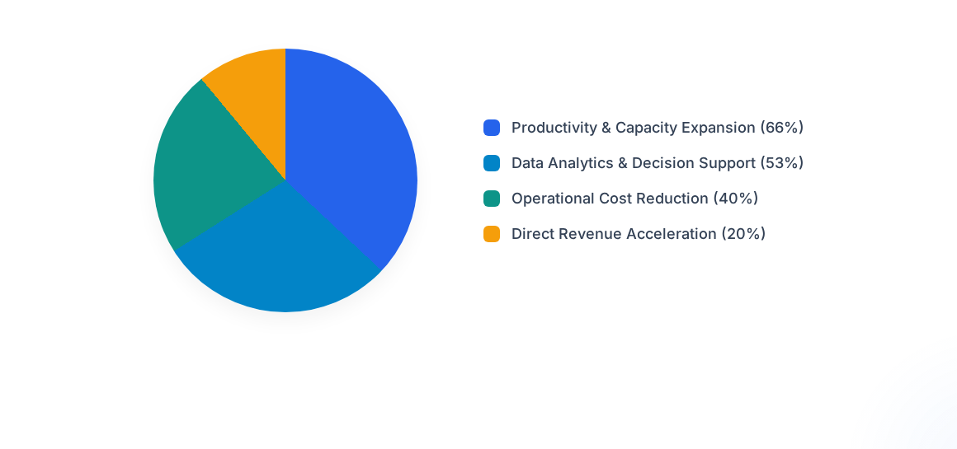
Primary Enterprise Value Drivers
Initial value capture is dominated by productivity gains. Sustained leadership requires shifting from simple efficiency gains toward new market revenue models.

Slide 9
AI Operating Model Matrix
Capability Tier | Primary Focus | Governance Complexity | Expected EBIT Impact
Desktop Copilots | Individual employee task assistance | Low (Standard User Guardrails) | 5% – 10% Personal Efficiency
Workflow Automation | Departmental rules-based tasks | Moderate (Role & Data Access) | 15% – 25% Time Savings
Autonomous AI Agents | End-to-end process orchestration | High (Auditability & Policy) | 30% – 50% Process Acceleration
Custom Industry AI | Core business model differentiation | Very High (Model Lineage & Risk) | Strategic Market Advantage

Slide 10




4-Stage Implementation Roadmap
Q2: Prove
Q4: Embed
Deploy one end-to-end production system and measure verified ROI metrics.
Integrate AI into annual planning, operating KPIs, and talent management frameworks.
Q1: Foundation
Q3: Scale
Map high-cost workflows, establish AI safety guardrails, and clean core data pipelines.
Expand agentic workflows across adjacent business units with central oversight.

Slide 11
Strategic Work Redesign
Deploying a copilot is the easy part. Redesigning how work actually gets done is the true leadership test.
“
Enterprise Technology & Strategy Report
Deloitte AI Pulse Check & State of AI 2026

Slide 12
Questions & Discussion
Let's map out your organization's tailored AI adoption strategy.
Strategic Advisory Team | enterprise-strategy@organization.com

Slide 13

Image Sources
https://png.pngtree.com/thumb_back/fw800/background/20251225/pngtree-futuristic-holographic-display-with-data-visualization-in-a-modern-presentation-room-image_20909826.webp
Source: pngtree.com

